Slide 1




Title
Presenter:
Name
Title
email
Phone
Date

Slide 2

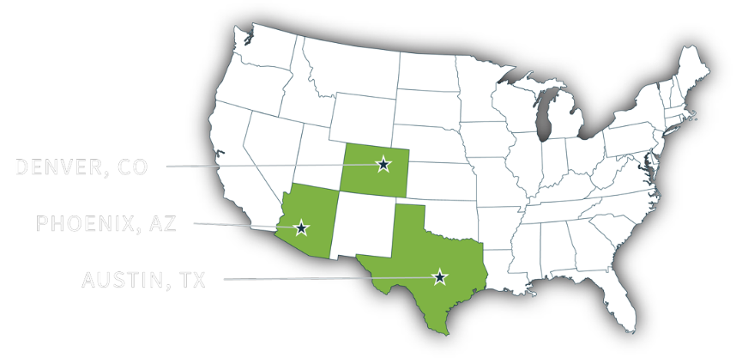
About CCIG
CCIG IS A FULL-SERVICE PRIVATE CLIENT, COMMERCIAL LINES, AND EMPLOYEE BENEFITS INSURANCE BROKERAGE.
Since 1985, CCIG has been a fiercely independent, rapidly growing insurance brokerage, delivering comprehensive risk management and insurance solutions to our diverse clientele. With a national presence, we employ over 100 seasoned insurance professionals and operate from our offices in Denver, CO, Austin, TX, and Pheonix, AZ.
PRIVATE CLIENT
PROPERTY & CASUALTY
EMPLOYEE BENEFITS
CCIG's Private Client Group consists of 17 insurance professionals. This group of high-caliber experts focuses exclusively on providing tailored, strategic risk management solutions for your lifestyle and financial milestones.
Family insurance program review, analysis, and recommendation summary.
Proactive renewal touchpoints at 60 days and 30 days before renewal.
CCIG provides the most comprehensive advice and tools needed to control costs and structure plans that meet the business’s strategic long-term goals.
We provide Program design and deductible optimization claims advocacy, claims reporting and trends, coverage review, and negotiation.
As well as safety Consulting, SAFE assessment, staff training, OSHA compliance, and cost containment programs.
We inspire our clients to think about healthcare in a new way, empowering them to take control of their future.
Our comprehensive approach includes care coordination, third-party administration, tailored stop-loss coverage, prescription benefits management (PBM), and cost-containment strategies.
With data we collect through our partners and actuaries, we paint a picture of both the present and the future to drive the direction of changes to the benefit program.
© CCIG All Rights Reserved
2

Slide 3
Your Team
Title
Name
Phone
email
Title
Name
Phone
email
Title
Name
Phone
email
Title
Name
Phone
email
Title
Name
Phone
email
Title
Name
Phone
email
Title
Name
Phone
email
Title
Name
Phone
email

Slide 4
Title
Coverage | Recommended Plan | Current Plan

Slide 5
Bar Chart
Chart description
*note.
Source:
Notes:
I need updated data

Slide 6

Transition Slide
© CCIG All Rights Reserved
6

Slide 7
Title
one
two
Text
Bullet 1
Bullet 2
Bullet 3

Slide 8
Title
Text
Text
Text
Text

